Slide 1
Group Project
Level 4/5 Group 19
Ogheneochuko Ideh
Samuel Ormondroyd
Thomas Barrett

Slide 2
Sling It Wing It (Working title)
Presented to:
Stakeholders & Ubisoft Bucharest
01/02/2017

Slide 3
Logline
Fling your bird as far as physically possible whilst flapping their wings to achieve greater distances.
Notes:
The logline for our game goes as follows:

Slide 4
Market Overview
Projected demographics | Unisex audience. Primarily targeted from ages 7 – 14 Appropriate for children (and adults) ages seven and up.
Genre: | The double A: Action, Arcade
Platform Specs: | Windows Unity Excecutable
Notes:
Before we begin, here is a brief run through of our market overview/game specs.
Projected demographic: We are targeting our game off the success of the games such as angry birds. The game will be geared towards children of both genders from 7 and up, although the game is also open to a universal audience.
This is because the game will use easy to learn physics mechanics that will prove very difficult to master.
The genre of our game is something we dubbed; Double A.
This is Action & Arcade.
The premise and overall goal is to beat your opponents score.
Platform Specs:
The game will be playable on PCs as a Windows executable file.

Slide 5
Generated Ideas
After our initial research, we met as a team and brought forth these ideas:
A ragdoll fighter game using WASD-style controls (or A, B, X and Y) where players knock their opponent down without falling over themselves due to lack of balance.
+ Uses simultaneously adversary functionality so with careful tuning, the game could be fast paced and deliver heated action.
- Learning curve is restricted to maintaining balance and knocking down their opponent so after numerous attempts, players can become masterful with the controls.
A racing game featuring time trials and fast pace platform traversal.
+ This also uses simultaneous adversary functionality so players can race head-to-head whilst racing ghostly copies of their fastest times to continually improve.
- Learning curve is restricted to the knowledge of the level; a randomly generated level would alleviate this issue but would be tough to implement in early builds.
Ideas continued on next slide…

Slide 6
Generated Ideas
A ‘Crazy Bones’ style throwing game to hit your opponents ‘bones’ without them hitting yours on an uneven and jagged terrain causing them to bounce awkwardly.
+ Uneven surfaces can alter the trajectory of the ‘bones’ which creates awkward bounces.
- Tough to emulate in a 2D environment for early builds and removes the 3D element of the bounces.
An ‘OLO’ style game consisting of different shapes would create different bounces.
+ Different shape collisions can cause other shapes to slide in all manners of directions, providing the game with unpredictability.
Simply an adaptation to OLO and not original.
This then lead to our agreed game idea…

Slide 7
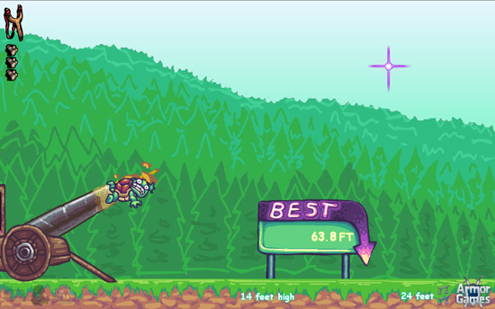
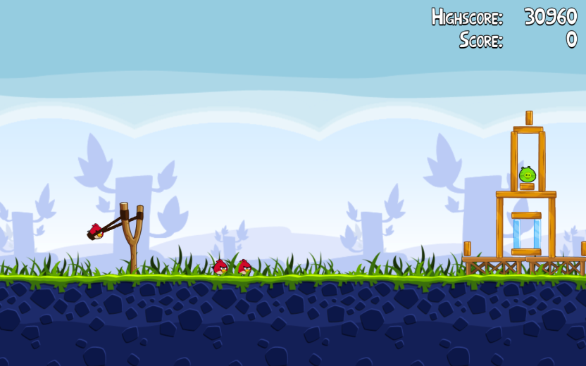
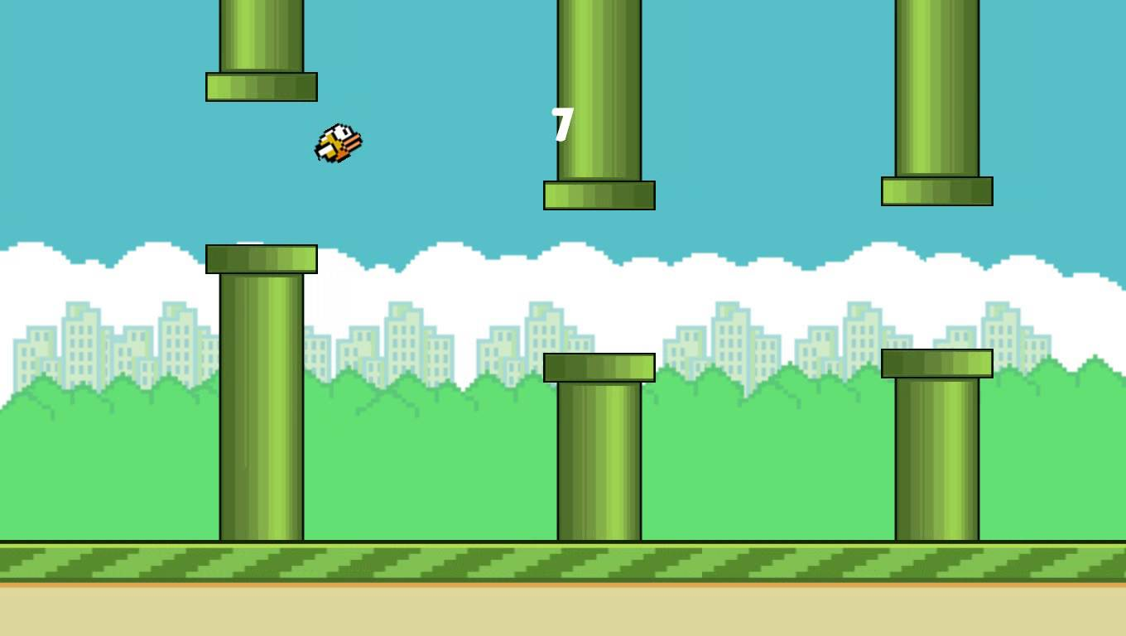
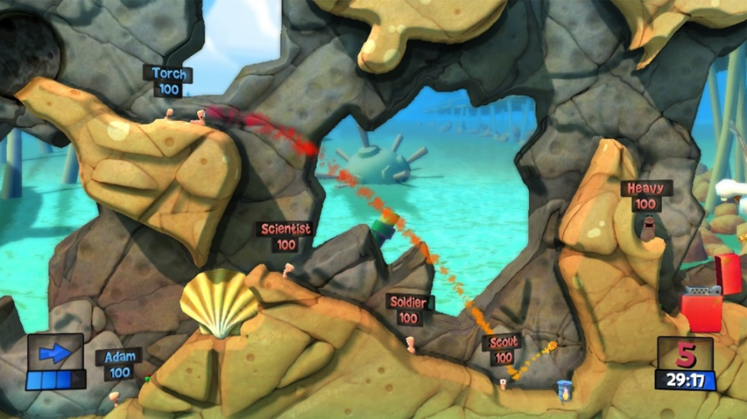
Inspirations
Toss the Turtle
Angry Birds
Flappy Bird
Worms
Notes:
During our research, we were fond of games which featured trajectory and momentum as central mechanics.
These mechanics take centre stage in games such as ......... Etc.
We aimed to incorporate these mechanic as they would allow players to play strategically, as they will be calculating where the projectile will land and how far it could travel.

Slide 8
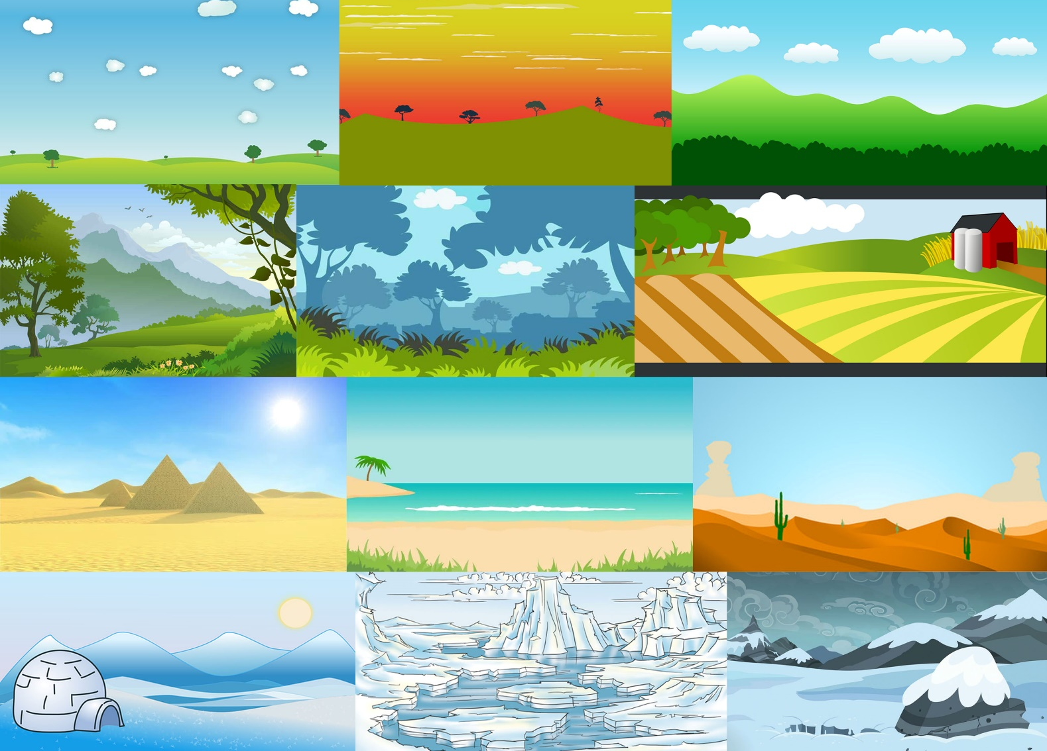
Moodboards and concept
Notes:
The mood board display multiple suggestive background themes for the games level. These themes are based around birds and their habitats.
Foregrounds will be developed to run along side the background. The foreground being the main playing field of the game will house uneven geometry posing as a challenge for players.

Slide 9
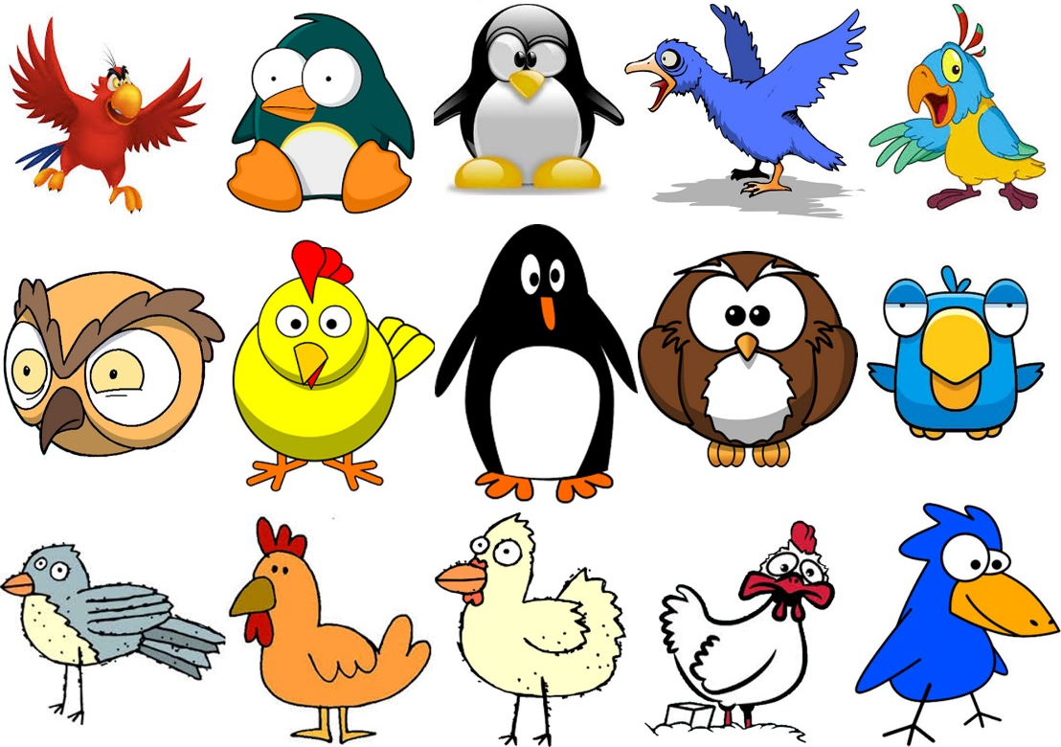
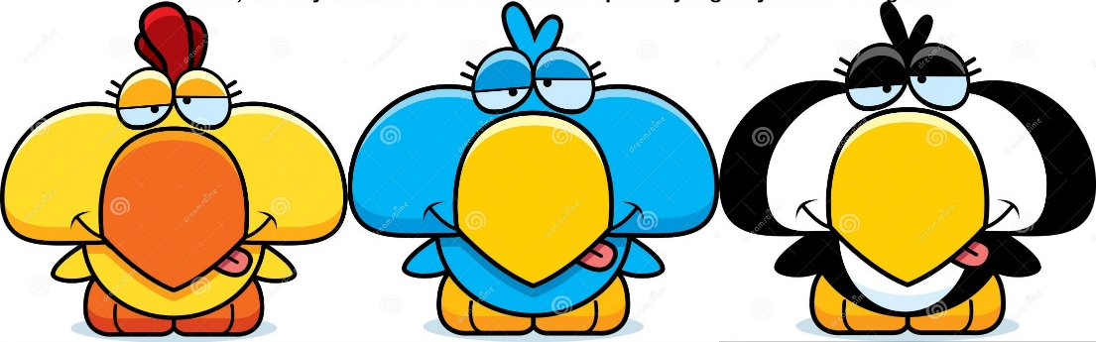
Moodboards and concept
Notes:
Using cartoon like and quirky art will add to the overall comedic tone of our game.

Slide 10
Game play and Appearance
Prototype Showcase
Action, physics, adversary, turn based game.
Main gameplay will take place on landscape 2D over-world.
Using the catapult, players can adjust the trajectory and momentum of the flightless birds in order to travel the farthest distance.

Slide 11
Game play and Appearance
Prototype Showcase
Players can use the stamina to either thrust bird upwards or forwards.
Thrusting forwards allows the bird to travel higher, thereby increasing the momentum of eventual impact.
Players can trust be repeatedly pressing the allocated keys, which in turn causes a twitch mechanic.
The larger the momentum upon impact, the further the bird will recoil.

Slide 12
Game play and Appearance
Prototype Showcase
Thrusting forward will allow the bird to travel further prior to impact.
Players stamina is restricted to a stamina bar seen in the UI.
The more a player thrusts the less stamina they will have in turn.
Budgeting stamina will in turn cause players to be strategic when planning to use their thrust function. Allowing for an overall strategic play.

Slide 13
Game play and Appearance
Prototype Showcase
Players may also use the thrust function to avoid geometry based obstacles that may affect the distance traveled.
Once the player's bird comes to a halt the distance traveled is calculated and stored leading into the next players turn.
The player who travels the furthest wins the round.
The game consists of three rounds, best two out three wins the game.

Slide 14
Prototype Showcase

Slide 15
Player Roles and Actions
The main objective: Travel the farthest whilst budgeting stamina.
Secondary objective: Avoid crashing into the terrain which may draw travelled distance to a halt.
Players thrust using twitch controls.
Working with trajectory, momentum and careful use stamina allows for a strategic play.
No two attempts will yield identical results.

Slide 16
Achieving Fun
Hard Fun
People fun
Serious fun
Notes:
Hard fun: Goals (greatest distance travelled) Obstacles (the terrain) and Strategy (using the stamina resource wisely)
People fun: Compete against each other, this creates a mix of positive/negative emotions i.e. amusement, stress, proud etc.
Serious fun: Repetition, Rhythm, players can learn quickly and iterate their experiences to fly a great distance or beat their opponents; new experiences creates excitement.

Slide 17
Scope and End Goals
We are here
End goals
Strech goals
End goals
Functional two player build.
Procedurally generated terrain.
Sound FX and background music.
Strech goals
Sprite animation for flapping of the wings and facial expressions.
Parallax scrolling background.
Possible stamina gains through the use of pick-ups.

Slide 18
Thanks for watching!
Questions?

Slide 19
Things to change (Not to be included in the pitch)
Steer away from turn-based play towards simultaneous -> Suit our target audience’s needs.
Spellchecks/Grammar (all should be clear in this version)
Add a slide to show the ‘Simple yet Effective’ rules (i.e. controls, how to fling, how to fly)

